Slide 1
COMPUTER HARDWARE

Slide 2
The word computer refers to an object that can accept some input and produce some output. In fact, the human brain itself is a sophisticated computer, and scientists are learning more about how it …

Slide 3
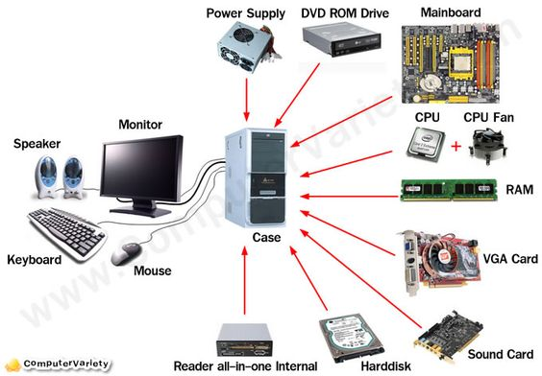

Slide 4
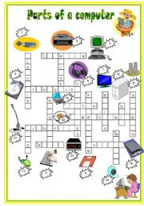

Slide 5
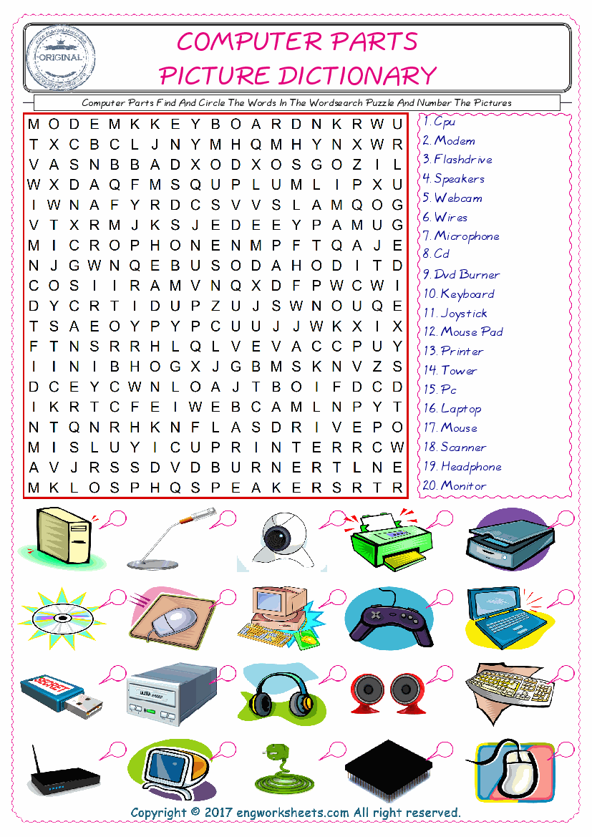

Slide 6
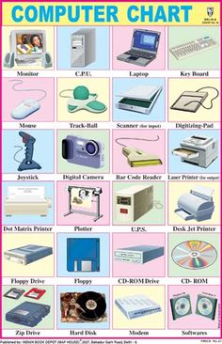

Slide 7
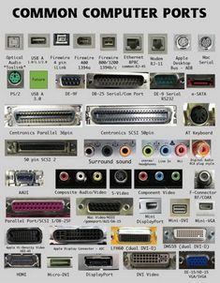
COMMON COMPUTER PARTS

Slide 8
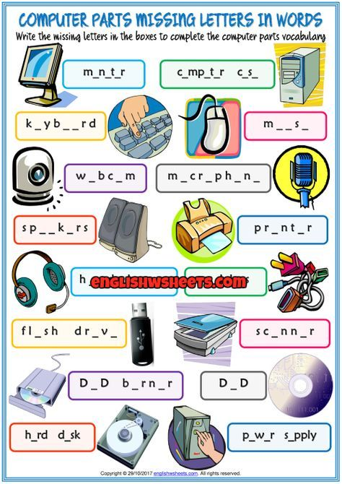

Slide 9
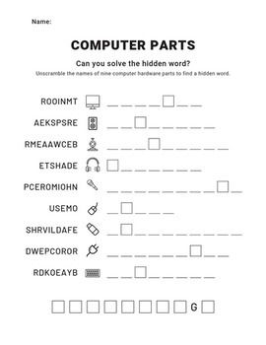

Slide 10
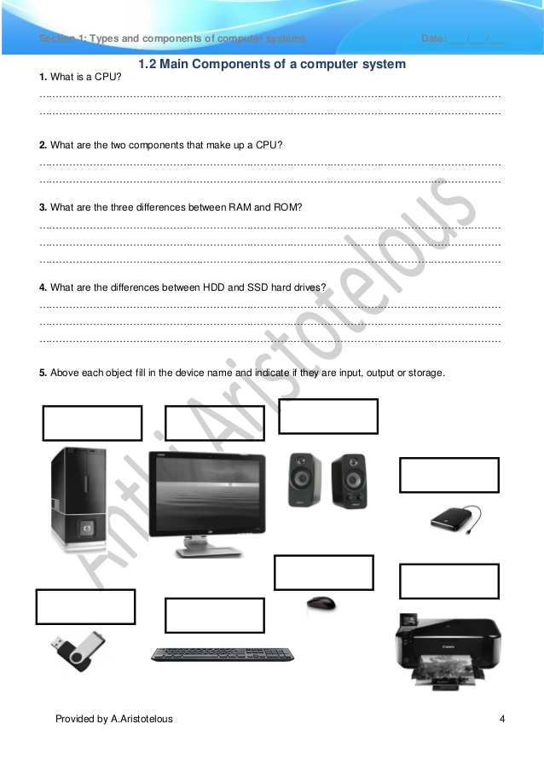

Slide 11
